Slide 1
AI Agent for Digital Financial Literacy
CAPSTONE PROJECT
Presented By: Ravi Kumar
Student name : Ravi Kumar
College Name & Department : NITK / CDS

Slide 2
OUTLINE
Problem Statement
Technology used
Wow factor
End users
Result
Conclusion
Git-hub Link
Future scope
IBM Certifications

Slide 3
Problem Statement
AI Agent for Digital Financial Literacy
The Challenge – An AI Agent for Digital Financial Literacy, powered by RAG (Retrieval-Augmented Generation), helps users understand and navigate essential financial tools and practices. It retrieves reliable content on using UPI, avoiding online scams, understanding interest rates, budgeting, and personal finance management from government portals, banking websites, and educational platforms. With multilingual support, users from diverse backgrounds can interact in their preferred language and ask questions like “How do I send money via UPI?” or “What is a safe interest rate for a loan?” The agent ensures financial literacy is accessible, personalized, and culturally inclusive. This AI-driven assistant empowers users with knowledge, protects them from fraud, and builds confidence in digital finance. Technology – Use of IBM Cloud Lite services / IBM Granite is mandatory
Proposed Solution: The proposed solution is a multilingual AI assistant powered by IBM Granite and RAG on IBM Cloud Lite. It retrieves reliable financial content (e.g., UPI, RBI FAQs), vectorizes it, and generates grounded answers using Watsonx.ai. IBM Language Translator adds regional language support, making digital financial knowledge accessible and fraud-resistant.

Slide 4
Technology used
IBM cloud lite services
Natural Language Processing (NLP)
Retrieval Augmented Generation (RAG)
IBM Granite model

Slide 5
IBM cloud services used
IBM Cloud Watsonx AI Studio
IBM Cloud Watsonx AI runtime
IBM Cloud Agent Lab
IBM Granite foundation model

Slide 6
Wow factors
🔍 RAG-powered Precision: Combines document retrieval with Granite LLMs for highly accurate, context-aware answers.
🌐 Multilingual Interaction: Supports queries in regional languages using IBM Language Translator for inclusivity.
🔒 Fraud Prevention Focus: Educates users on scam avoidance and secure digital finance practices.
☁ Fully IBM Cloud Lite Hosted: Built end-to-end on free-tier IBM services—no external tools needed.

Slide 7
End users
General Public
First-time Smartphone/UPI User
Students and Young Adults
Low-Income or Unbanked Individuals

Slide 8
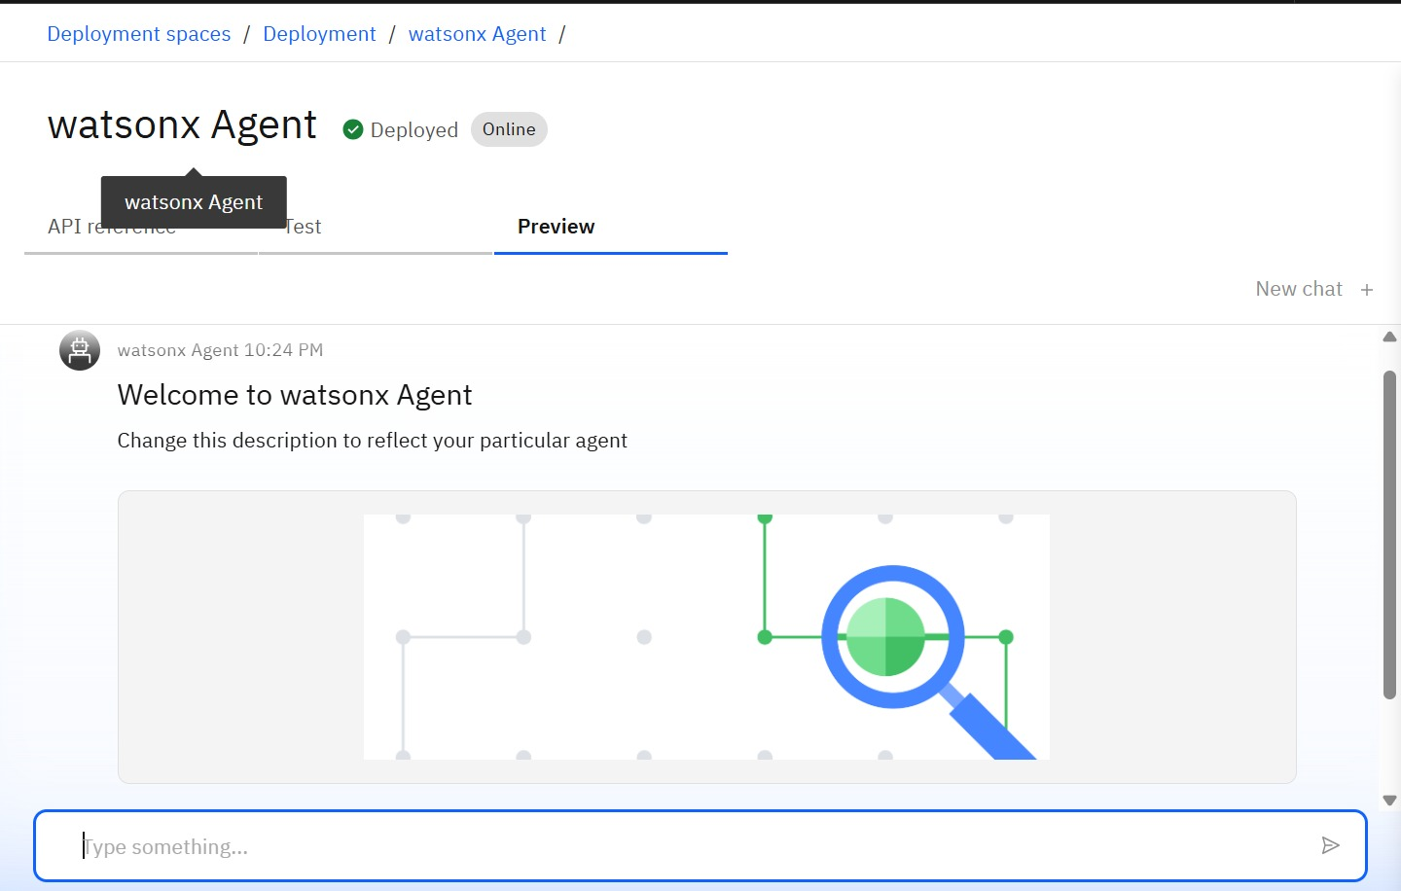
Results

Slide 9
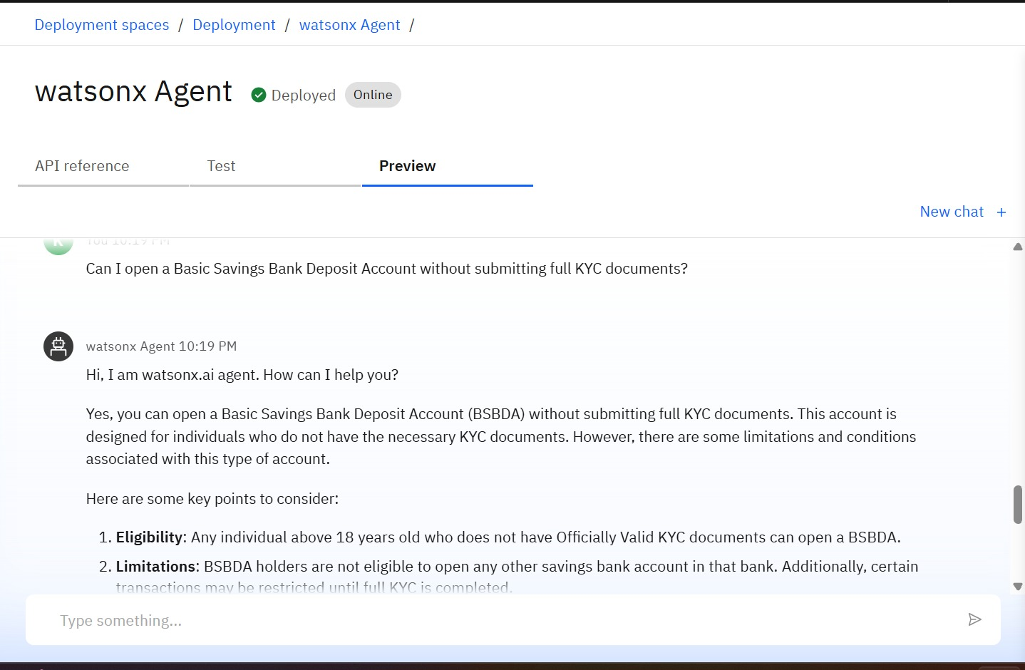
Results

Slide 10
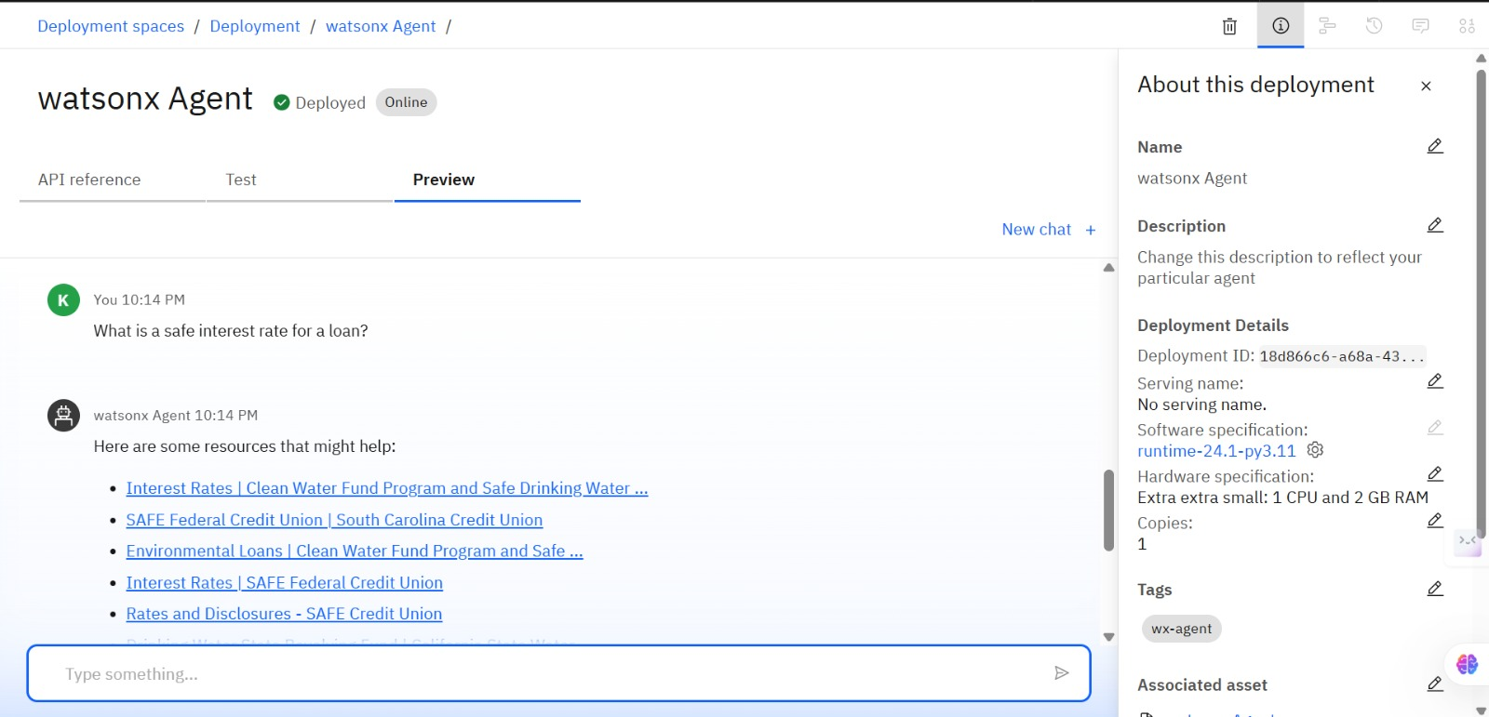
Results

Slide 11
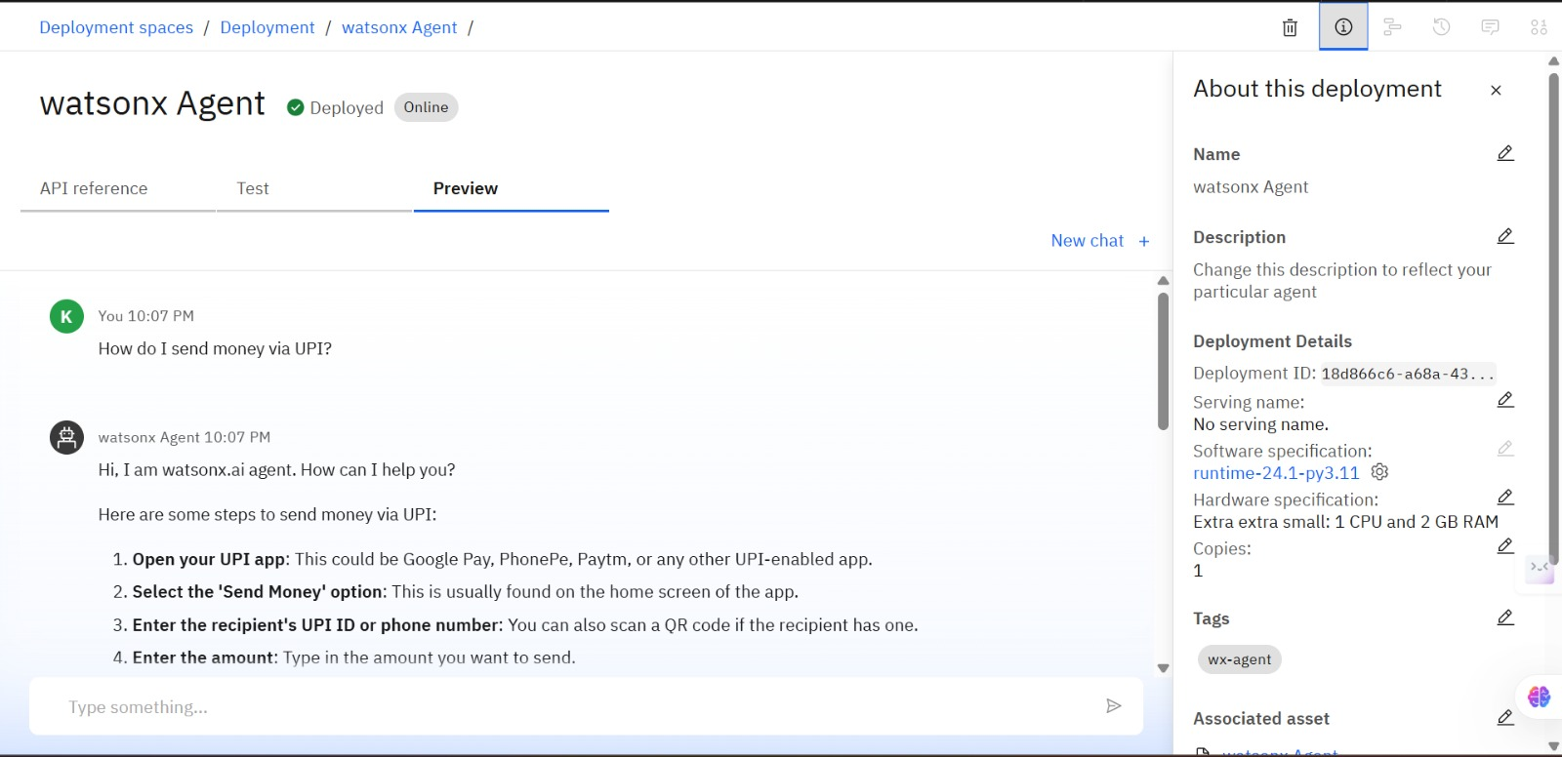
Results

Slide 12
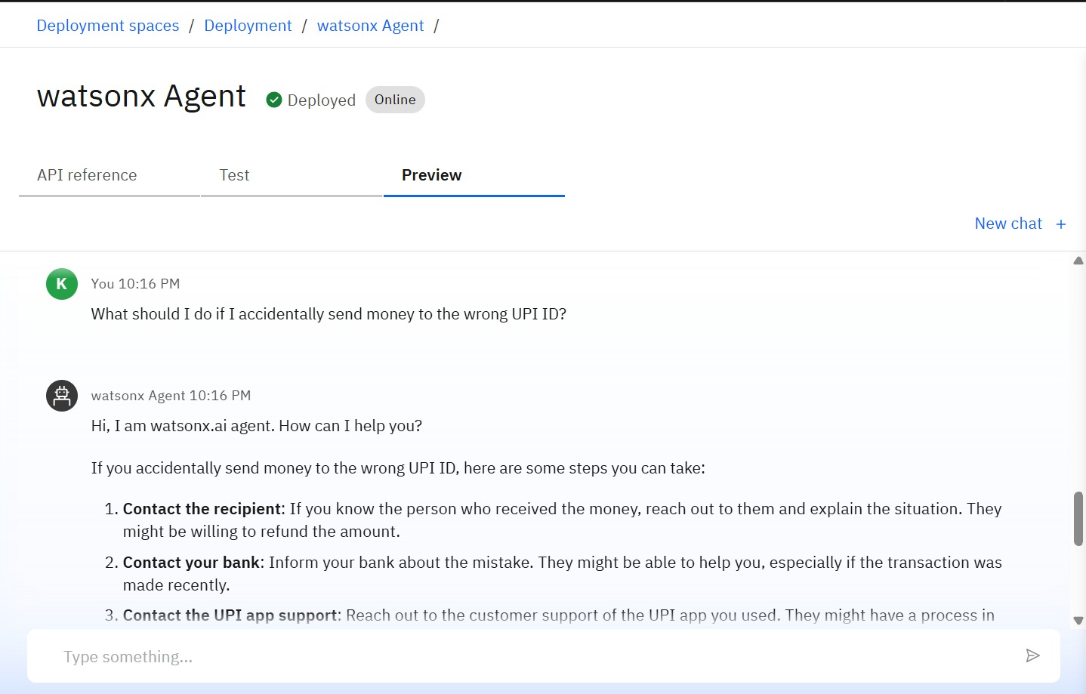
Results

Slide 13
Conclusion
FinGuide Agent empowers users with accurate, safe, and grounded financial knowledge.
It supports diverse language users, bridging the gap in digital financial literacy.
Powered by IBM Watsonx.ai and Granite models, it ensures context-aware, reliable answers.

Slide 14
Future scope
Wider Language Support
Mobile App Integration
Expanded Knowledge Base
Voice Assistant Integration

Slide 15

IBM Certifications

Slide 16
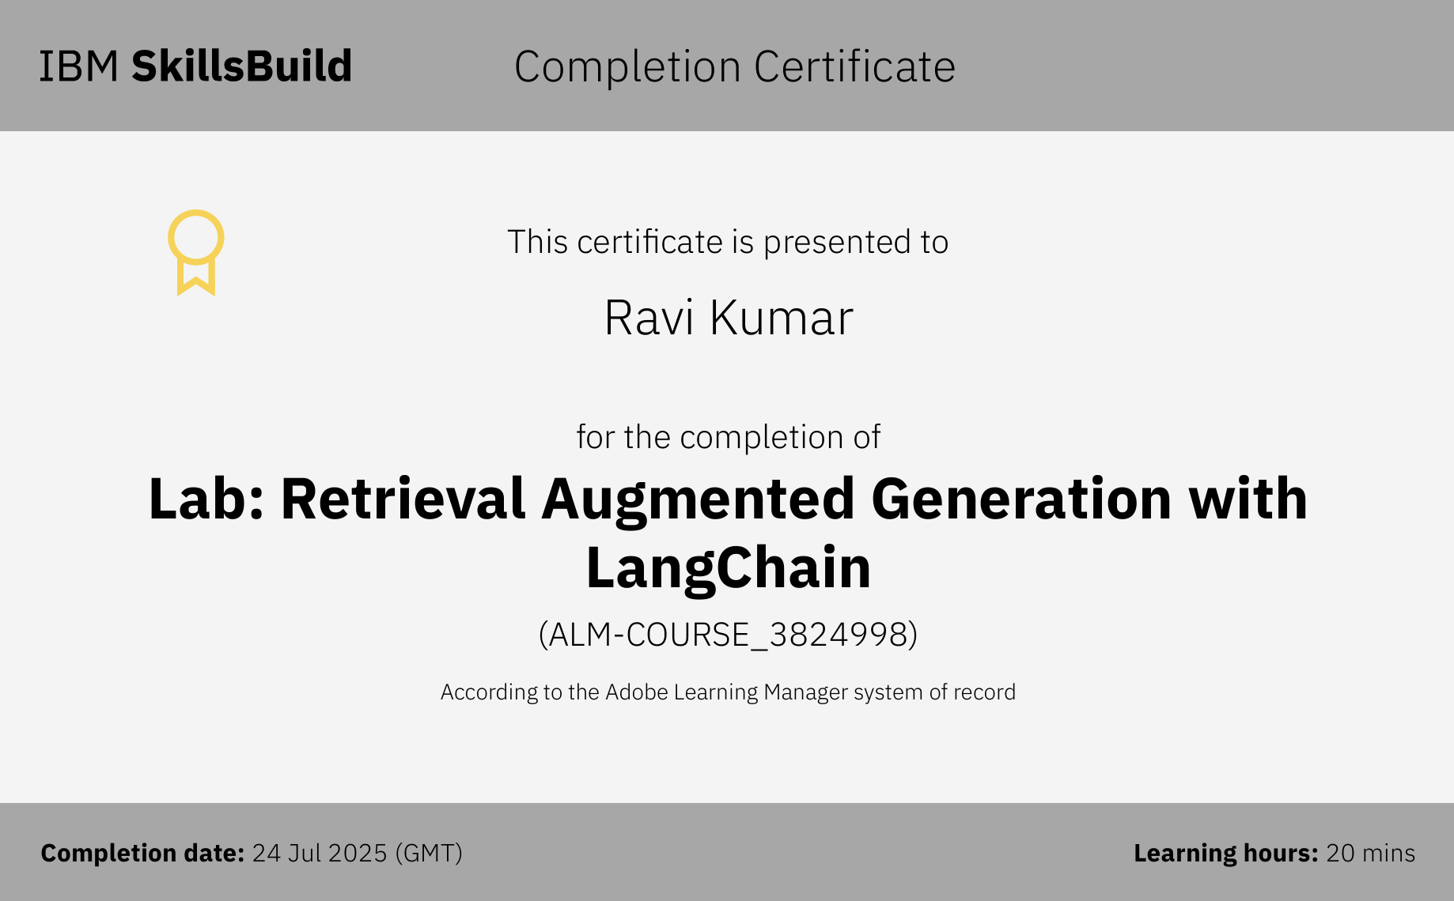

Slide 17


Slide 18
GitHub Link
Github link:- https://github.com/ravikumar2217/AI-Agent-for-Digital-Financial-Literacy

Slide 19
THANK YOU

